Slide 1
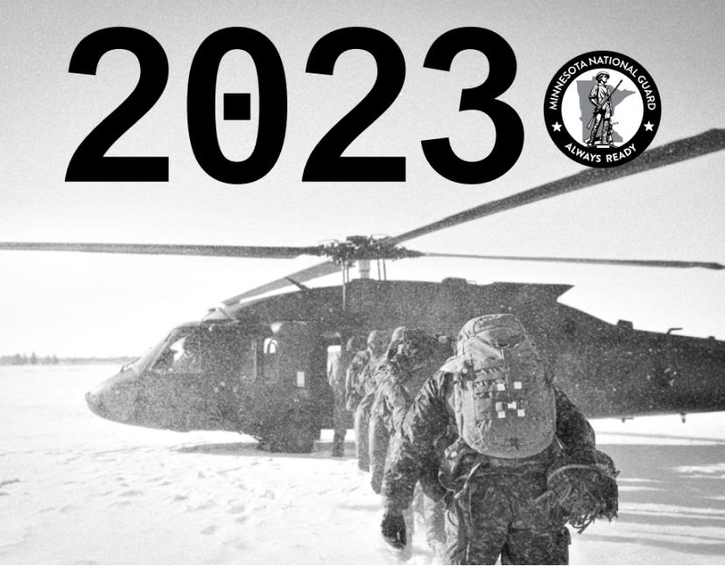
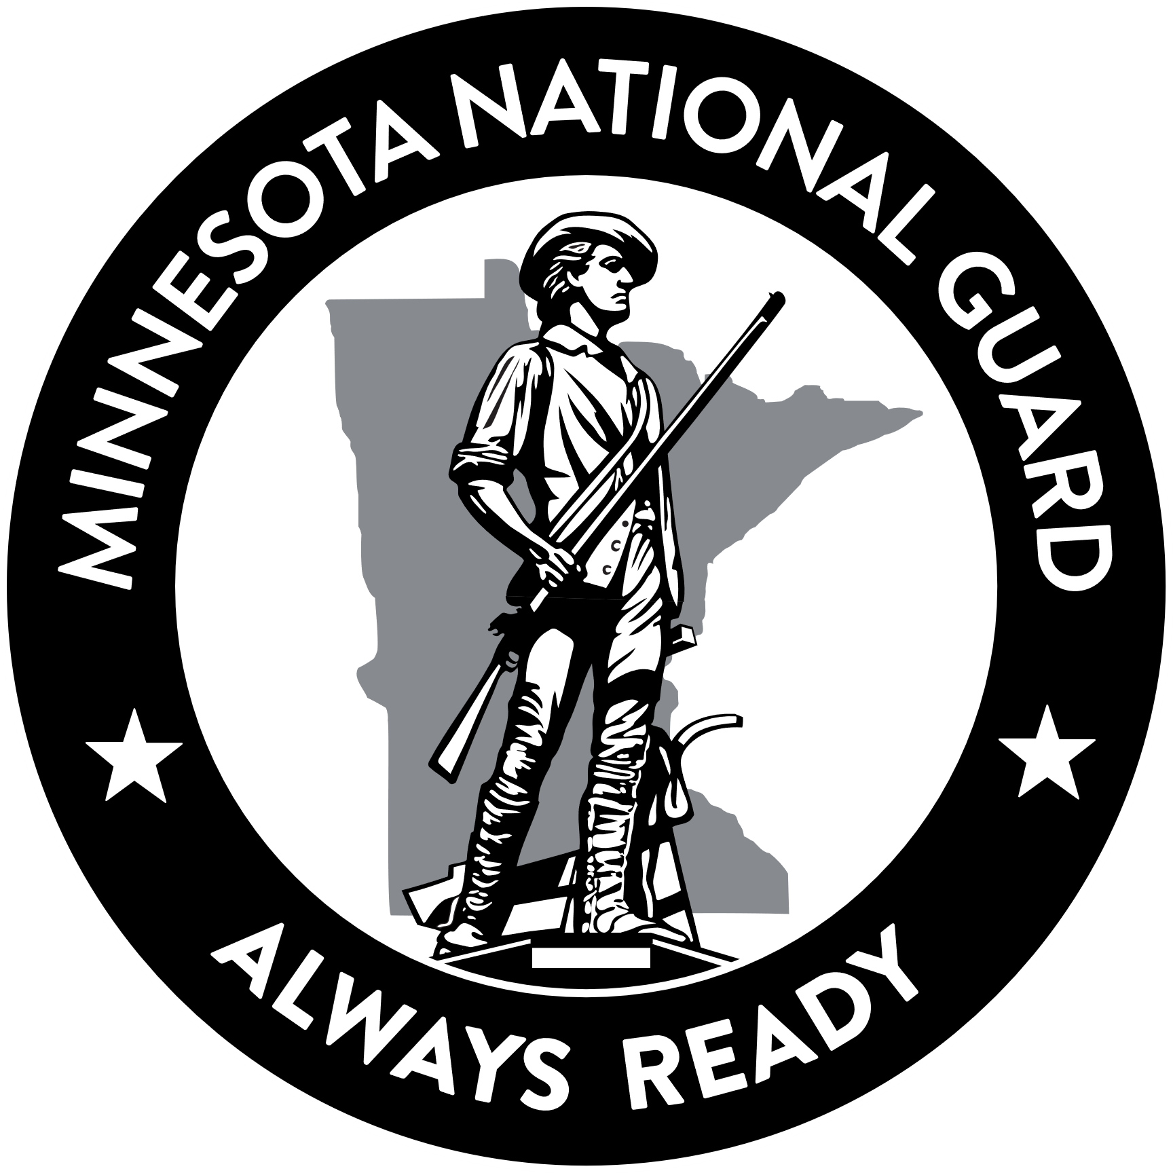
Guard 101
Minnesota National Guard
Notes:
Greetings! I am _____________.
It is a pleasure to be here today to discuss the Minnesota National Guard and the Department of Military Affairs.
Thank you for this opportunity to inform you of the current status and future of your Minnesota National Guard. can continue to be the most cost-effective operational force that leverages the skills of our most talented and our most-committed citizens for the vital missions that we serve both at home in Minnesota and abroad.

Slide 2
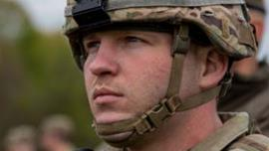
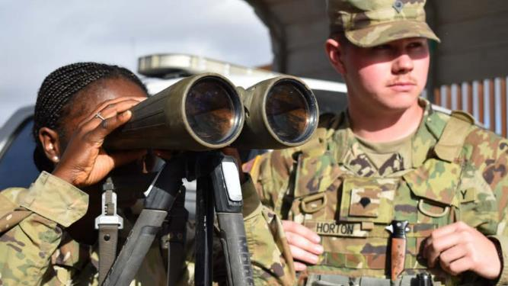
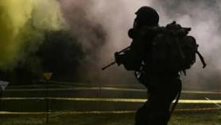
Overview
13,000 Soldiers & Airmen
Full-time and part time
Dual Mission
Oath to the U.S. and MN
Located across Minnesota
In more than 50 communities
Notes:
Although the Minnesota National Guard was formed in 1856, the oldest annual report that our historians have located is from 1892 and is shared electronically on our website. That year’s document reported that the Guard consisted of ten companies of infantry, two troops of cavalry, and two sections of artillery, with a total strength of 844 Soldiers.
Today, your Minnesota National Guard is nearly 13,000 strong - Minnesotans who have put on the uniform and sworn to defend our State and Nation. Much has changed since the beginning of your Guard,
The Minnesota National Guard has 13,000 Soldiers and Airmen from communities across the state of Minnesota. They serve in a variety of full and part-time roles.
We have a dual mission: Members of the Minnesota National Guard swear an oath to both the President of the United States and the Governor of Minnesota. So, we have both a federal mission and a state mission.
Members are located all across MN: The Minnesota National Guard operates out of facilities in more than 50 communities throughout our state. We are continually optimizing the physical capabilities at each location to meet mission requirements and enhance local community partnerships.

Slide 3
Leadership
TAG
MG Manke
(State Military)
Director, Joint Staff
(Federal Military)
Executive Director
(State Civilian)
ARNG Units
(Federal Military)
Camp Ripley Training Center
ANG Units
(Federal Military)
ARNG Staff Element
Army Manning,
Army Training,
Army Logistics,
Communications & Army Network Support
(Federal Mil/Civ)
Joint Staff Element
Support to Civil Authorities, Domestic Operations &Plans, Intelligence, Joint Logistics, Legal Oversight, Human Resources (Federal Mil/Civ)
ANG Staff Element
AF Manning
AF Training, AF Logistics,
Communications and Network Support (Federal Mil/Civ)
Sustainment
Finance, HR, Payroll , Military Incentives, P & C, Internal Audit, Safety & Health, Quartermaster,
MSABC
(State Mil/Civ)
Operations
Military Outreach,
Support to Military Operations, Quartermaster, Plans, Facility Security, Fire Protection, ATFP, ESS, Air Traffic
(State Mil/Civ)
Notes:
Here is a graph depicting the leadership for the MN NG. The Adjutant General, Major General Shawn Manke, is the commander of the State only under the Governor, Tim Walz.

Slide 4
Full time staff/Traditional
Full Time Staff
Citizen Soldiers and Airmen
State
Employees
Federal
Army National Guard
Full Time Staff are only a small portion of the overall Minnesota National Guard. They enable the readiness of the units and equipment.
Federal
Air National Guard
= 100
Notes:
This slide depicts the scale of investment in the department between the federal and state government, and between the full-time staff and the traditional National Guard force.
The Department of Military Affairs employs 380 state employees. They provide the interface between state and federal programs, and function through a Cooperative Agreement between TAG and the Chief of the National Guard Bureau to provide services like fire protection, security, and other support to the National Guard.

Slide 5
Organizational Priorities
People
Modernization
Partnerships
Notes:
Our organizational priorities remain unchanged since the fall of 2021 and focus on People, Modernization, and Partnerships. Communication is central to advancing our priorities. Each priority is supported and tied together by communication to our internal and external audiences across the state, nation, and world-wide.
We continually seek ways to develop, enable and care for people; modernize and optimize our capabilities and force structure; and build relationships that lead to greater mission success.

Slide 6
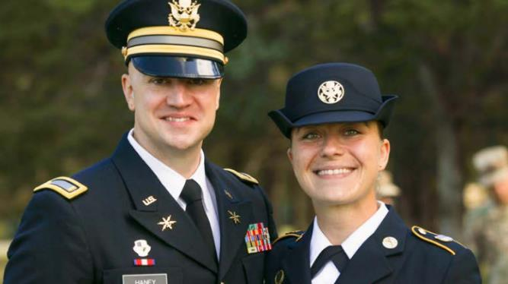
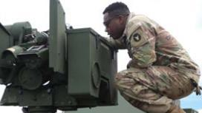
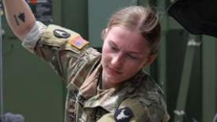
Priority—people
People are at the center of any successful organization.
Investment in our Soldiers, Airmen, and civilian employees give our organization the means to tackle the challenges our state and nation face and promote the value of choosing to serve as citizen-Soldiers and Airmen.
Notes:
Our Soldiers, Airmen and civilian employees are our most important resources. We’re grateful for their sacrifices as well as the sacrifices of their families and employers.
We believe in treating people with dignity and respect, and we seek to be a diverse and inclusive organization that celebrates and benefits from a wide variety of backgrounds and experiences. We focus on growth and provide critical feedback to develop our service members into professional, ethical and caring leaders. We cherish and value the lives of all those who serve in the Minnesota National Guard, and we demand and maintain a culture and a workplace that is safe from internal and external physical threats.

Slide 7
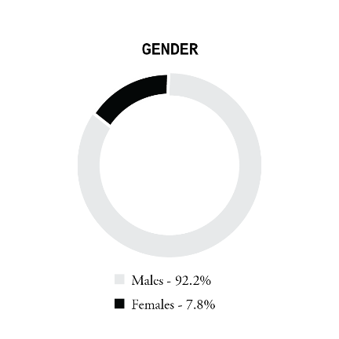
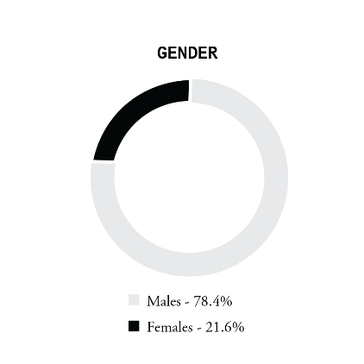
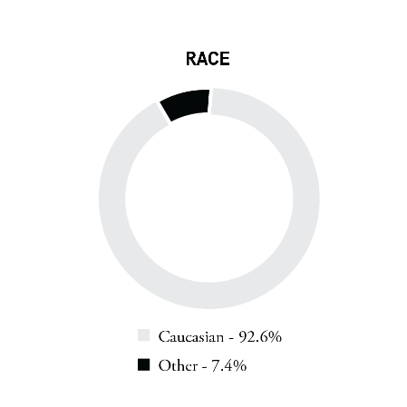
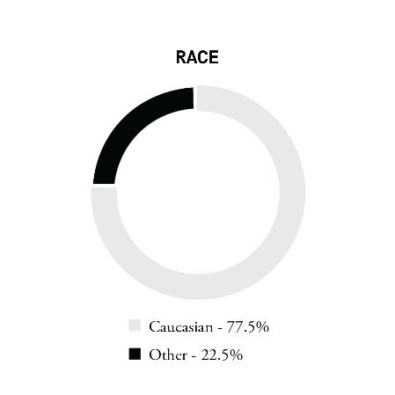
People & Diversity
2011
Gender
2023
Increased in our force in diversity from 2011 to 2023
Females have increased 13.8%
Minorities have increased 15.1%
2011
Race
2023
Notes:
Within our organizational priority of people, we focus on the importance of diversity and inclusion within our ranks.
We believe in treating people with dignity and respect, and we seek to be a diverse and inclusive organization that celebrates and benefits from a wide variety of backgrounds and experiences. We focus on growth and provide critical feedback to develop our service members into professional, ethical and caring leaders. We cherish and value the lives of all those who serve in the Minnesota National Guard, and we demand and maintain a culture and a workplace that is safe from internal and external physical threats.
The graphs shown depict our growth from 2011 to 2023 in regard to gender and race. In 2011 only 7.8% of the MN National Guard were females but in 2023 that number went up to 21.6%. The growth in diversity is similar. In 2011 only 7.4% of the MN National Guard was minorities but in 2023 that number went up to 22.5%. Minorities include black, Asian, native American, and Hispanics.

Slide 8
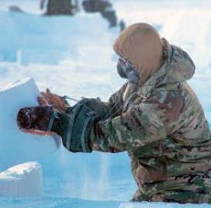
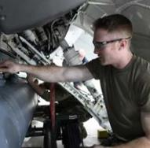
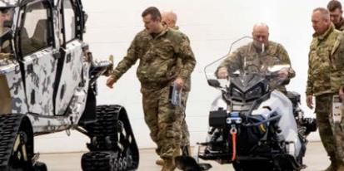
Priority—Modernization
Modernization ensures we have the right forces, infrastructure, training spaces, and systems for our current and future missions.
As our challenges and adversaries change, we require forces, equipment, and training to ensure our state and national security.
Notes:
We maintain a strong commitment to the modernization of our force. To remain relevant, ready and highly capable in the face of ever-changing missions, we are intent on instituting the most up-to-date training, equipment, facilities and the like.

Slide 9
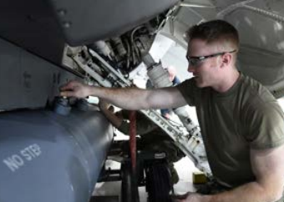
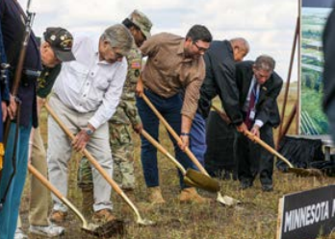
Modernization Highlights
New all-weather radar pod, AN/ASQ-236
Military museum at Camp Ripley
Health of the force
Armories renovation
8 new C-130J Super Hercules aircrafts
18 new M109A7 Paladin howitzers
Notes:
Here are the key highlights from this last year in terms of modernization:
The 148th Fighter Wing in Duluth, received a new all-weather radar pod and tested it for their F-16. They then created a plan how the National Guard will operationalize the pod for all F-16 fighter aircrafts. The pod is an externally mounted Active Electronically Scanned Array (AESA) pod that provides detailed maps for surveillance, coordinate generation and bomb impact assessment purposes.
The new military museum, located just outside of Camp Ripley, broke ground this past fall and will be $32 million facility. The 40,000 square-foot museum will sit on a 30-acre plot. The museum aims to show how Minnesota service members and Veterans have been involved in shaping our nation’s military growth and development.
The health of the force is very important, people is another one of our priorities. Systems and programs that were updated this past year are the Integrated Primary Prevention Workforce, Holistic Health & Fitness Program, Resilience, Risk Reduction, & Suicide Prevention Program, and Family Programs.
One of our biggest modernization highlight is the renovation of various armories around the state. The staff held stationing working groups – planning meetings to determine where Soldiers train while their armory is renovated. This working group continually reviews the age of our armories and the feasibility of renovating them.
133rd Airlift Wing will receive eight new C-130J Super Hercules aircraft to improve mission efficiency further, utilize new technologies, and increase their ability to deliver logistics anytime, anywhere for the state and nation.
the 1st Battalion, 125th Field Artillery Regiment, fired new weapons systems, following a year of enhanced modernization efforts that saw the unit receive 18 of the Army’s newest M109A7 Paladin howitzers. Fielding and training on the systems marks one of the most significant equipment upgrades for Minnesota’s field artillery community in more than two decades.

Slide 10
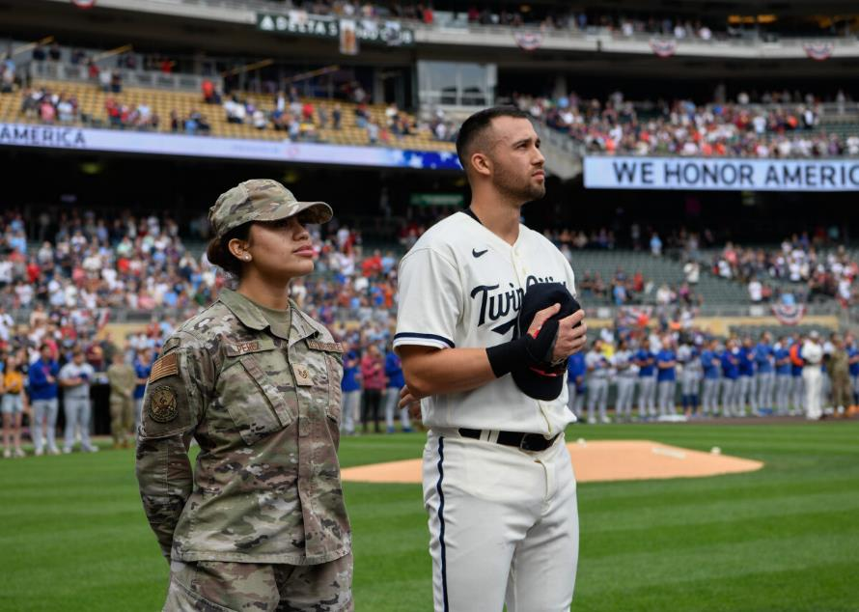
Priority—Partnerships
A wide range of partners
local community groups
state agencies
civil authorities
national departments and institutions
international organizations and allies
State Partnership Program (SPP)
Notes:
We value relationships with a wide range of partners, including local community groups, state agencies and civil authorities, national departments and institutions, and international organizations and allies. We strive to foster relationships that help us to better serve our communities, state, and nation.
We are also apart of the State Partnership Program (SPP) with Croatia and Norway. The SPP, which links a state's National Guard with the armed forces or equivalent of a partner country in a cooperative, mutually beneficial relationship. The program encourages the development of economic, political and military connections between the states and partner nations.

Slide 11
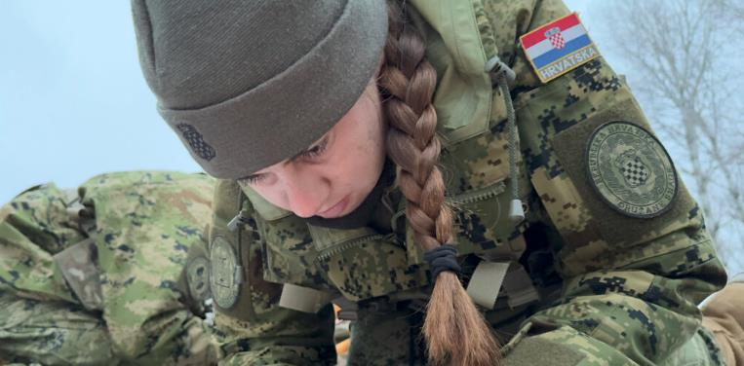
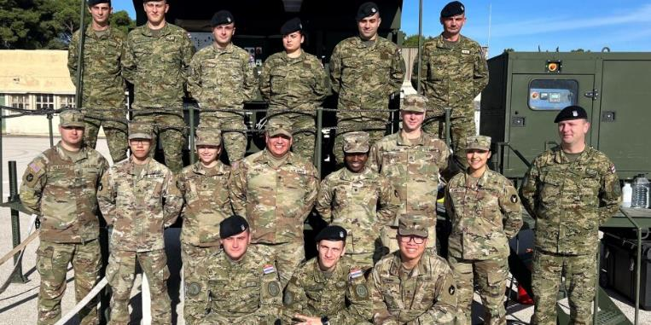
Country partnership Croatia
State Partnership Program
Since 1996, leaders and members of the Minnesota National Guard and the nation of Croatia have been collaborating and building relationships within the framework of the National Guard Bureau's State Partnership Program (SPP).
Notes:
Croatia: In 2023, the Minnesota National Guard celebrated its 27th year, partnering with the nation of Croatia. Each year, Minnesota and Croatia work together to enhance our respective organizations and strengthen our ongoing partnership.

Slide 12
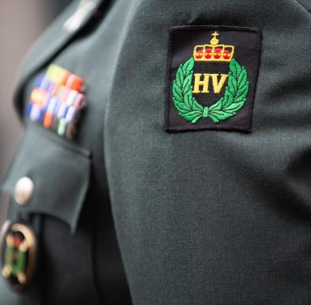
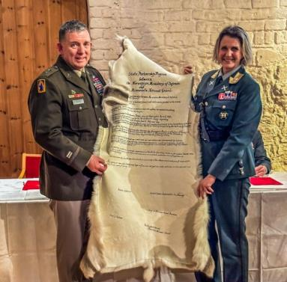
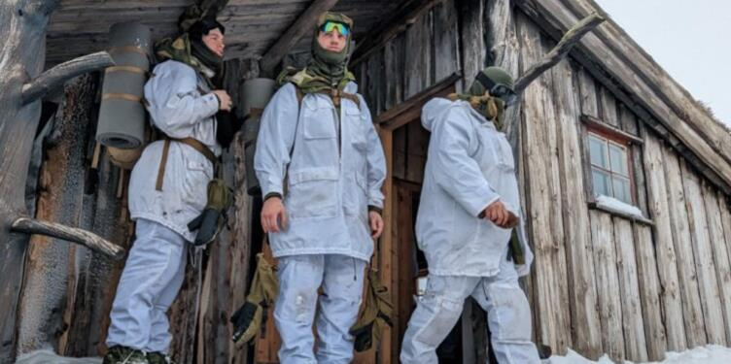
Country partnership Norway
Norway became an official SPP member in 2023 with Minnesota after 50 years of conducting NOREX.
This partnership will increase the Minnesota National Guard’s interoperability with a NATO ally and build upon already established ties.
Notes:
On February 15, 2023, leaders from the National Guard Bureau, Minnesota, and Norway signed an official State Partnership Program agreement in Norway to further expand their 50-year relationship officially becoming an SPP member with Minnesota.
This partnership will increase the Minnesota National Guard’s interoperability with a NATO ally and build upon already established ties.

Slide 13
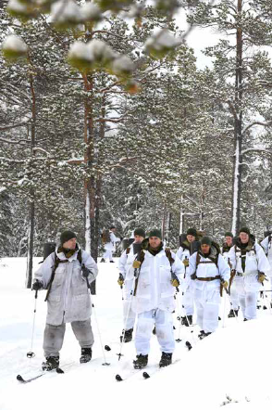
Longest Bilateral partnership Norway
U.S. Norway Reciprocal Troop Exchange
The Minnesota National Guard continues to execute the country's longest-running troop exchange with the Norwegian Home Guard, a partnership initiative that started in 1974.
Soldiers and Airmen trade places to experience each other’s training, military lifestyle and culture.
Notes:
In 2023, the Minnesota National Guard celebrated its 50th year, partnering with the nation of Norway which is the country's longest-running troop exchange. The exchange, a tradition spanning nearly five decades, reinforces the positive working relationships between allied services and highlights the strong lineage many Minnesotans share with the Scandinavian culture.

Slide 14
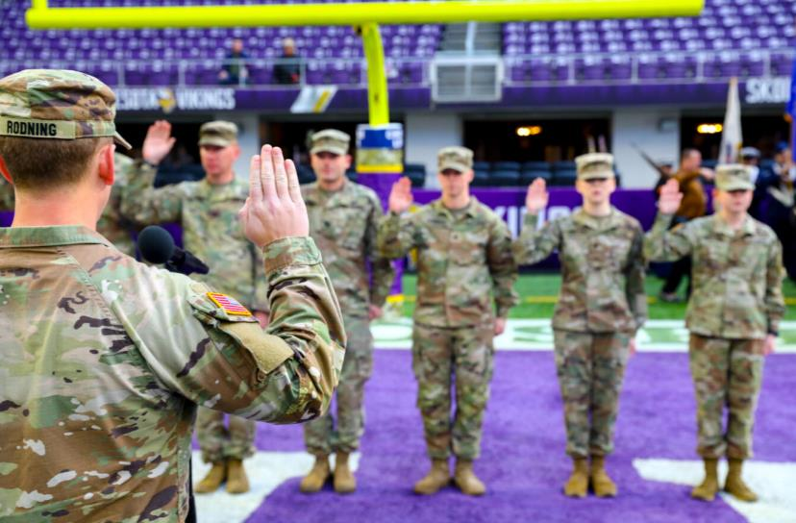
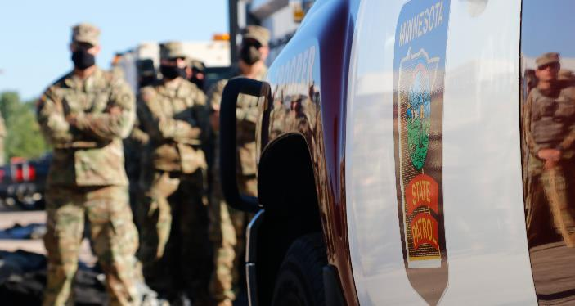
Community Partnerships
Partnerships allow us to expand our reach, capabilities and effectiveness.
We develop meaningful relationships with stakeholders and our communities, and we cherish and build partnerships with local, state, national and international organizations. We strive to improve communication and operational efficiencies and effectiveness with partner agencies.
PARTNER ORGANIZATIONS
...AND MANY MORE.

Slide 15
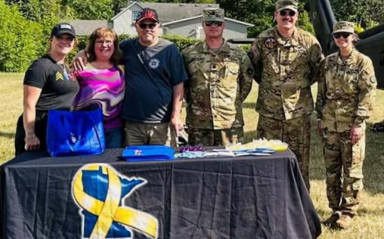
Beyond the yellow ribbon (BTYR)
Began in 2007
53 Cities
79 active companies and organizations
In 2023, they contributed more than $511,000 and 659,000 volunteer hours in support of the state’s military community.
Notes:
One of our close partnerships is with Beyond the yellow ribbon.
The mission of Beyond the Yellow Ribbon, also known as BTYR, is to establish and sustain a comprehensive community and corporate support network that connects and coordinates agencies, organizations, and resources to meet the needs of Minnesota’s veterans, service members, and families in all military branches. There are 53 cities and counties and 79 active companies and organizations in the BTYR network, which began in 2007. The combined efforts of the community and corporate networks make a significant impact. In 2023, they contributed more than $511,000 and 659,000 volunteer hours in support of the state’s military community.

Slide 16
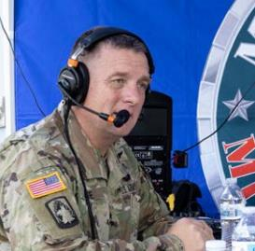
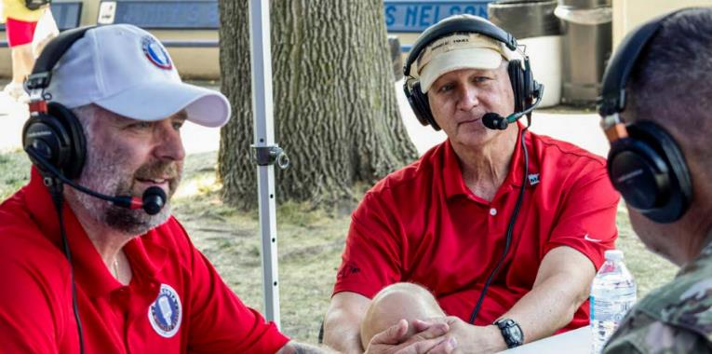
Minnesota Military radio
Minnesota Military Radio began in 2010 and has many great accomplishments:
2011, traveled to Kuwait to visit the 1st Armored Brigade Combat Team
2016 & 2019, the program joined Serving Our Troops to bring a piece of Minnesota to deployed service members
2017 & 2023, the show traveled to Norway, capturing the excitement of the Norwegian Exchange
2023, 13 years on the air and 700 unique shows recorded. On 66 live radio stations across the state and worldwide via podcast
Notes:
At the heart of Minnesota Military Radio are the partnerships it has formed with the Minnesota National Guard, Beyond the Yellow Ribbon, Minnesota Department of Veterans Affairs, and the Minneapolis VA.
MN Military radio began in 2010 when Vietnam Veteran Tom Lyons was asked to host a weekly program to discuss topics relevant to Minnesota’s military and Veteran communities. The show has many great accomplishments which are listed

Slide 17
Economic impact
Notes:
Now I want to highlight the positive economic impact and value that the Guard provides the state and nation.
The Minnesota National Guard receives more than 96% of its funding from the federal government to maintain our readiness. State funds — although a small percentage — are critical to meet matching fund requirements for federally reimbursed state positions, construction and asset preservation projects for our facilities throughout the state.
Of our approximately 13,000 Soldiers and Airmen, about 2,000 are full-time employees.
We have 61 facilities in 58 communities throughout the state. We are committed to staying in greater Minnesota, as those communities have been loyal to us for decades providing us with loyal, hardworking Soldiers and Airmen generation after generation.
We also make a large impact in the communities in which we reside by providing stable, long-term jobs and community leaders. And with these full and part-time employees in Minnesota towns, it makes an impact on local businesses. You can see a city-by-city economic impact breakdown in our annual report.

Slide 18
Major subordinate commands
Joint Force Headquarters
Camp Ripley Training Center
148th Fighter Wing
34th Infantry Division Red Bulls
133rd Airlift Wing
1st Armored Brigade
Combat Team
347th Regional
Support Group
84th Troop Command
175th Regional
Training Institute
34th Expeditionary
Combat Aviation Brigade
Medical Detachment
Notes:
Here’s a quick overview of the major commands that make up the Minnesota National Guard, including Joint Force Headquarters, which provides oversight of all National Guard forces, two Wings that provide Air capabilities, and several Army units that power our operations on the ground. We’ll take a high-level look at the mission and capabilities of each of these organizations.

Slide 19
JFHQ
Joint Force Headquarters, Saint Paul
A joint Army and Air National Guard unit tasked to oversee operations for all state National Guard forces.
The Joint Force Headquarters (JFHQ) coordinates military support at the request of the governor in the event of a disaster or state emergency.
Notes:
Joint Force Headquarters is located in Saint Paul. And has a strength of 433 soldiers for their headquarters and 12,627 in their subordinate units.
A joint Army and Air National Guard unit tasked to oversee operations for all state National Guard forces.
The Joint Force Headquarters (JFHQ) coordinates military support at the request of the governor in the event of a disaster or state emergency.
2023 accomplishments include
Joint Force Headquarters staff supporting the State Partnership Program letter of intent signing ceremony, the 50th anniversary of the U.S.-Norwegian Reciprocal Troop Exchange, and activity day for more than 100 Norwegians. During activity day, they had the opportunity to shop and to experience the Saint Paul Winter Carnival.
Modernization of armories meant the renovation across the state. The staff held stationing working groups – planning meetings to determine where Soldiers train while their armory is renovated. This working group continually reviews the age of our armories and the feasibility of renovating them.
IPPS-A stands which stands for Integrated Personnel and Pay System-Army, the third release of this system began in 2023 and took six months to complete. This was the largest fielding in military history across the U.S. of a human resource system with 1.5 million users.

Slide 20
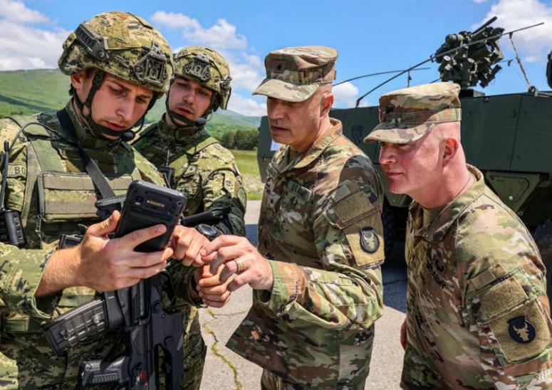
34th ID
34th Infantry Division “Red Bulls,” Arden Hills
Provides training and readiness oversight for nine National Guard brigades with more than 23,000 Soldiers across Minnesota and eleven other States.
In Minnesota, the 34ID includes the 1st Armored Brigade Combat Team (ABCT), 34th Expeditionary Combat Aviation Brigade (ECAB), 84th Troop Command, and the 347th Regional Support Group.
Notes:
34th ID, located in Arden Hills has a strength of 679 soldiers for their headquarters and 9,451 soldiers in their subordinate units.
Provides training and readiness oversight for nine National Guard brigades with more than 23,000 Soldiers across Minnesota and eleven other States.
In Minnesota, the 34ID includes the 1st Armored Brigade Combat Team (ABCT), 34th Expeditionary Combat Aviation Brigade (ECAB), 84th Troop Command, and the 347th Regional Support Group.
2023 accomplishments include
Immediate Response 23, known as IR23, was part of a more extensive combination of linked field training and live-fire exercises. Red Bulls successfully commanded and controlled three multi-national brigade task force elements with over 7,000 service members from a dozen NATO and European partner countries. IR23 enabled the division to continue to build upon its rich heritage and legacy in Europe.
Orion 23, a European exercise focused on preparing France to serve as a rapid reaction corps supporting large scale combat operations. Red Bulls operated as part of a NATO force, which provided unique opportunities for the command and staff to build competency across all warfighting functions in a multi-national environment.
Another exercise was held in Croatia with U.S. Army Europe and Africa, U.S. Army V Corps, and the Croatian Armed Forces to develop interoperability with NATO members and partners at the corps and division levels.
The Red Bulls are proud to have trained with the militaries of over a third of the members of NATO in 2023.

Slide 21
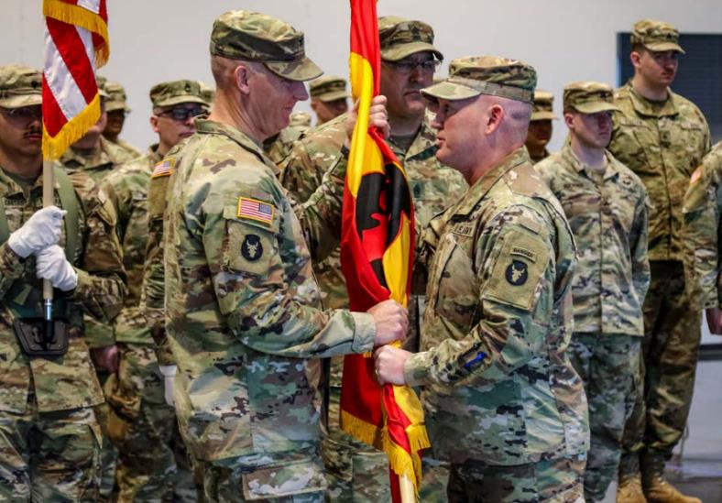
34th divarty
34th Division Artillery, Arden Hills
The first of eight such National Guard units. The unit increases capabilities at the division headquarters by providing long-range precision fires, command, and control of division-level artillery assets, fire support, and synchronization of joint fires.
Notes:
34th Division artillery, located in Arden Hills has a strength of 122 soldiers
The first of eight such National Guard units. The unit increases capabilities at the division headquarters by providing long-range precision fires, command, and control of division-level artillery assets, fire support, and synchronization of joint fires.
The unit will continue to build organizational and operational capacity over the next few years, formally reporting in 2025.
2023 accomplishments include
Staff members joined the 34th Infantry Division in support of U.S. Army Europe and Africa’s exercise, Defender Europe 23, held in Croatia.
The team held a symposium in 2023 focused on “The Division of 2030” which integrated intelligence, maneuver, and artillery leaders to share best practices and provide a forum for professional development.
Held a workshop for master gunners from aligned-for-training units. This event advanced the brigade’s previously established ‘Red Book’ and introduced an additional digital standard operating procedure, which enables units to conduct digital training in coordination with the brigade in the future.

Slide 22
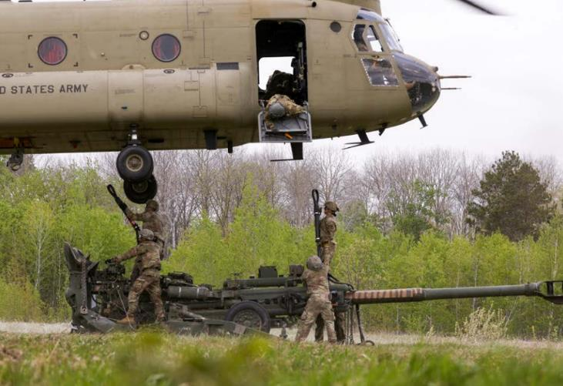
34th ecab
34th Expeditionary Combat Aviation Brigade, Inver Grove Heights
Provide UH-60 Black Hawk and CH-47 Chinook helicopter for federal and state missions.
Notes:
34th ECAB, located in inver grove heights, has a strength of 142 Soldiers in their headquarters and 1,000 Soldiers in their subordinate units
They support the 34th Infantry Division “Red Bulls” and the State of Minnesota. They provide UH-60 Black Hawk and CH-47 Chinook helicopter aviation capabilities for federal and state missions.
2023 accomplishments:
The unit conducted cross-border operations with the Canadian Lake Superior Scottish Regiment, performing an air movement of 73 Canadian Soldiers from Thunder Bay, Canada, to Camp Ripley, Minnesota.
The brigade began building command relationships with units that will soon fall under its command as it prepares to transition to a Combat Aviation Brigade in 2024.

Slide 23
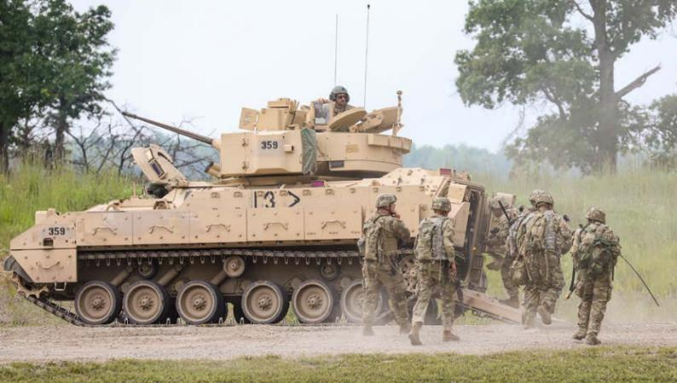
1st abct
1st Armored Brigade Combat Team, Rosemount
Constitute more than half of the Minnesota National Guard’s total soldier force.
Notes:
1st Armored Brigade Combat Team, located in Rosemount has a strength of 128 Soldiers in their headquarters and 4,779 Soldiers in their subordinate units
They consists of a headquarters and eight major subordinate commands. These Soldiers comprise the brigade’s combined arms, armor, cavalry, infantry, artillery, engineer, and brigade support battalions. They constitute more than half of the Minnesota National Guard’s total Soldier force. The brigade provides subordinate commands with timely and effective guidance to support state and federal requirements.
2023 Accomplishments:
The 1st Battalion, 125th Field Artillery Regiment, fired new weapons systems, following a year of enhanced modernization efforts that saw the unit receive 18 of the Army’s newest M109A7 Paladin howitzers. Fielding and training on the systems marks one of the most significant equipment upgrades for Minnesota’s field artillery community in more than two decades.
The first precision guidance kit round shot by a battalion crew was fired at Camp Ripley on June 20, highlighting capability and weapons enhancements.

Slide 24
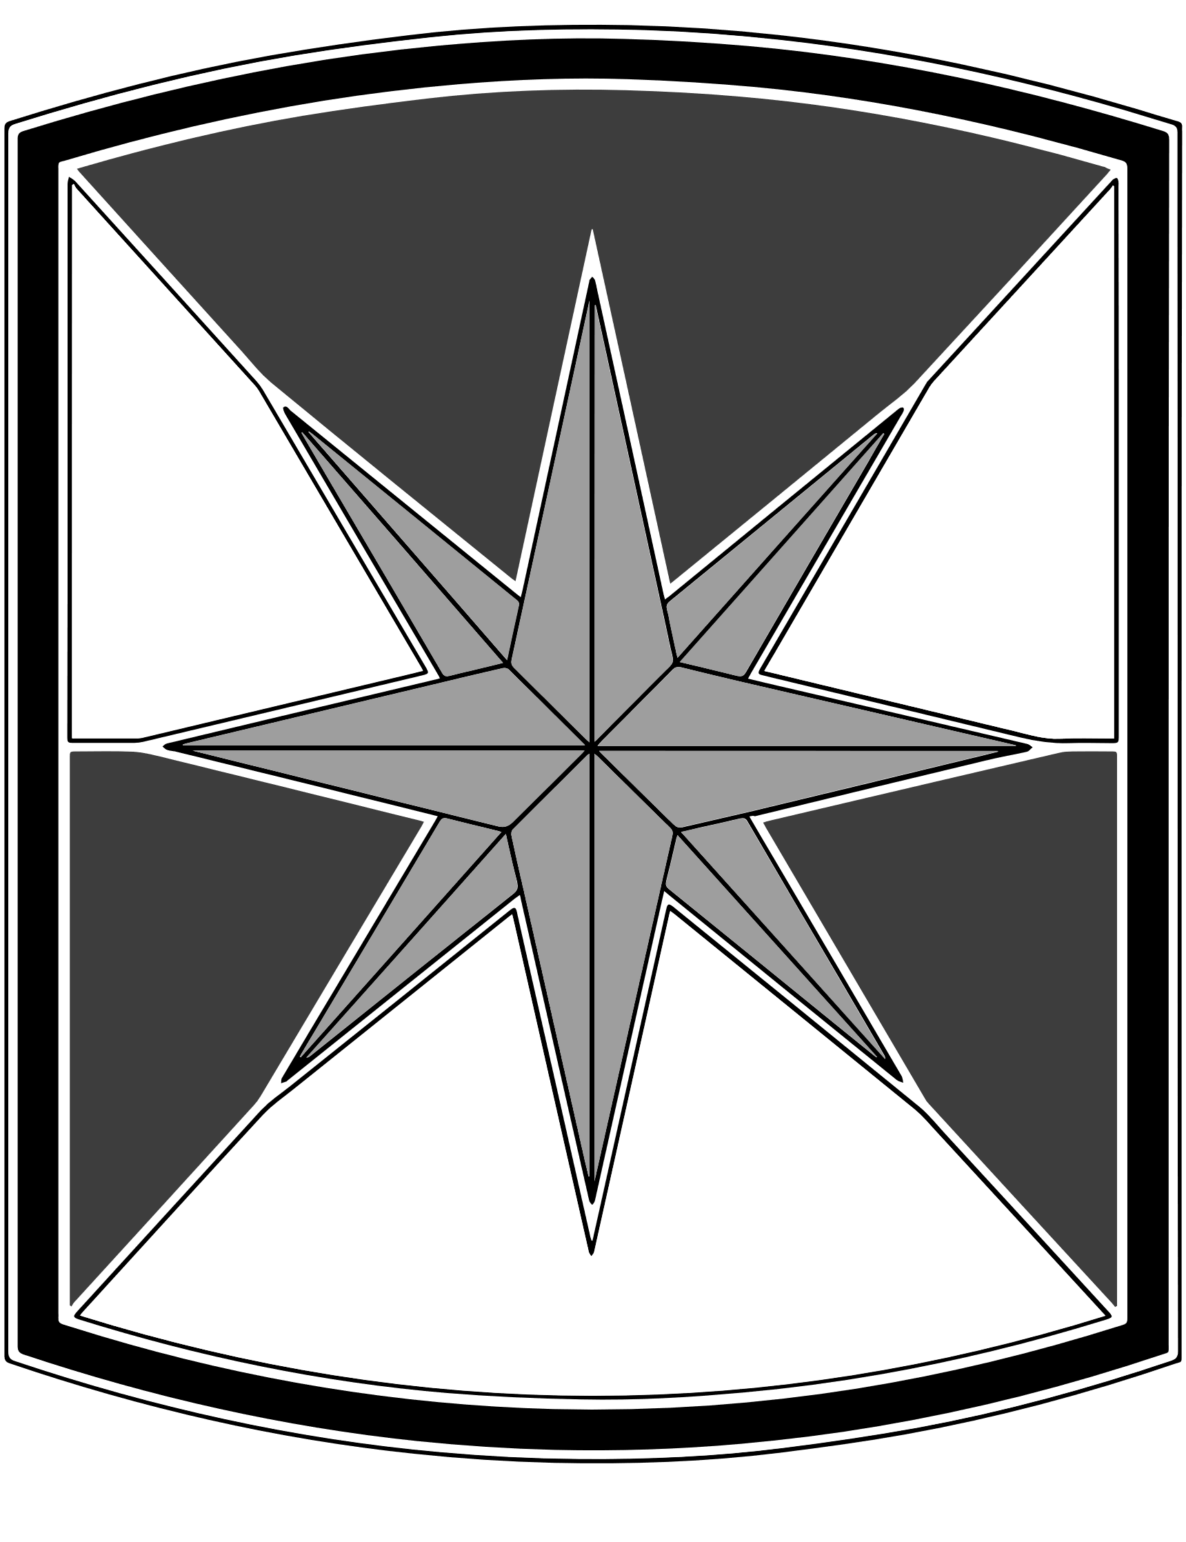
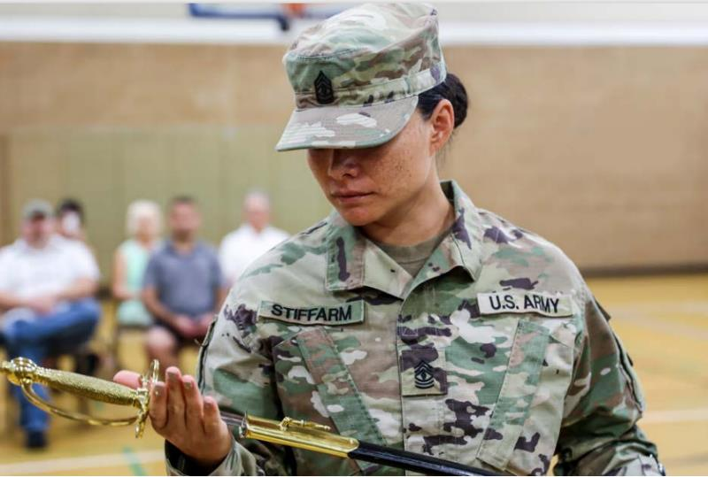
347th rsg
34th Regional Support Group, Brooklyn Park
Mission is to deploy and provide life support and command and control of military base operations.
The unit’s responsibilities include leading the reception, staging, onward movement, and integration of supporting forces as they arrive, managing facilities, and providing administrative, medical, and logistical support for troop services on a base camp.
Notes:
34th Regional Support Group, located in Brooklyn Park has a strength of 96 Soldiers in their headquarters and 1,146 Soldiers in their subordinate units.
Their mission is to deploy and provide life support and command and control of military base operations. The unit’s responsibilities include leading the reception, staging, onward movement, and integration of supporting forces as they arrive, managing facilities, and providing administrative, medical, and logistical support for troop services on a base camp. The 347th is higher headquarters to the 1347th Division Sustainment Support Battalion and eight separate units with distinct mission sets. The brigade’s companies also provide support for units during homeland security, homeland defense, and other civil support missions.
2023 accomplishments:
In 2023, the 347th Regional Support Group deployed multiple units to various locations:
Soldiers from the Headquarters Company returned from Iraq and Kuwait in support of Combined Joint Task Force – Operation Inherent Resolve
Soldiers from detachments one and two of the 147th Human Resources Company returned home from Kuwait
The 1903rd Acquisition Team mobilized to the Horn of Africa in support of Operation Inherent Resolve.

Slide 25
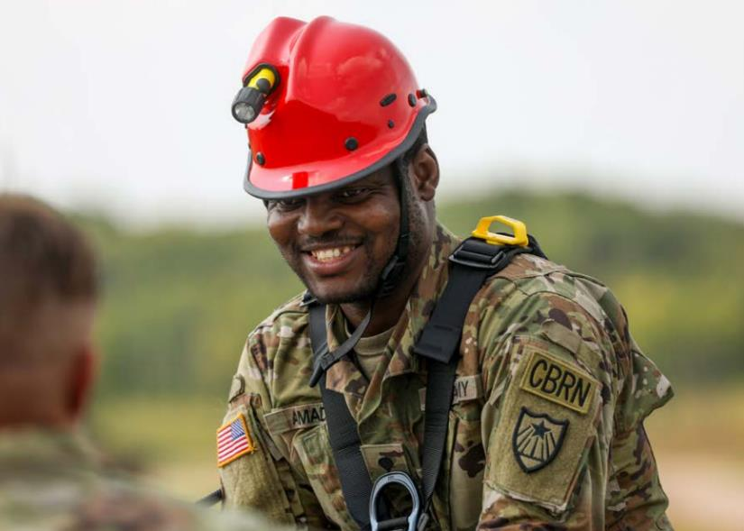
84th trc
84th Troop Command, Cambridge
Maintains control of field artillery, military police, engineer, and civil support forces, providing a force capable of performing a wide variety of missions.
A specialized command with a unique mission, the 84th Troop Command maintains training standards to remain ready to support federal missions in addition to conducting domestic operations throughout the state.
Notes:
84th Troop Command, Cambridge, has a strength of 47 Soldiers in headquarters and 1,640 in subordinate units.
Maintains control of field artillery, military police, engineer, and civil support forces, providing a force capable of performing a wide variety of missions.
A specialized command with a unique mission, the 84th Troop Command maintains training standards to remain ready to support federal missions in addition to conducting domestic operations throughout the state.
2023 accomplishments:
The headquarters of the 682nd Engineer Battalion, the 850th Horizontal Engineer Construction Company, and the 257th Military Police Company completed a year-long mission located at the Southwest border assisting U.S. Customs and Border Protection. Known as “Task Force Castle,” their mission spanned the border from California to Arizona. In addition to a highly successful and unique mission, Task Force Castle service members volunteered over 1,636 hours in surrounding communities.
The 1st Battalion of the151st Field Artillery Regiment participated in the 84th Troop Command best warrior competition. The 151st Field Artillery had competitors win both the brigade soldier and noncommissioned officer of the year.

Slide 26
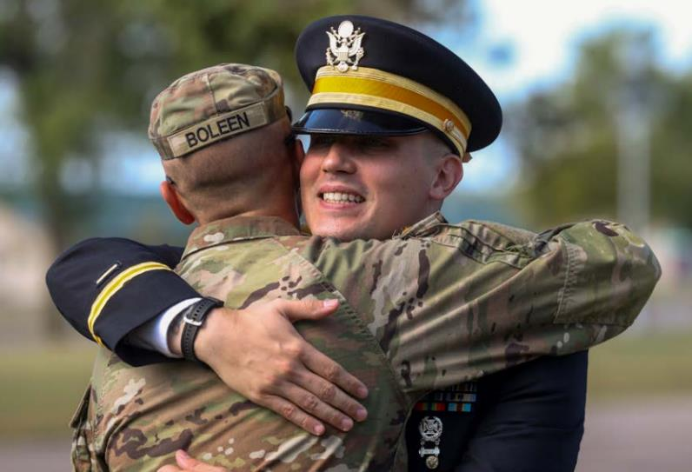
175th rti
175th Regional Training Institute, Little Falls
Provides combat arms, Military Occupational Specialty and leadership training to the U.S. Army to prepare Soldiers and units for deployment at maximum combat readiness levels.
Notes:
175th Regional Training Institute, Little Falls, has a strength of 24 Soldiers in headquarters and 97 in subordinate units.
Provides combat arms, Military Occupational Specialty and leadership training to the U.S. Army to prepare Soldiers and units for deployment at maximum combat readiness levels. Each year, hundreds of Soldiers from the National Guard, Reserve, and Active Components travel to Camp Ripley to attend one of more than 30 courses offered by the 175th Regional Training Institute.
2023 accomplishments:
In 2023, the 175th instructed 937 Soldiers from across the country.
The institute’s officer candidate school graduated 12 candidates with 11 commissioning and one candidate receiving an eligibility certificate.
The warrant officer candidate school graduated 10 candidates with all commissioning.

Slide 27
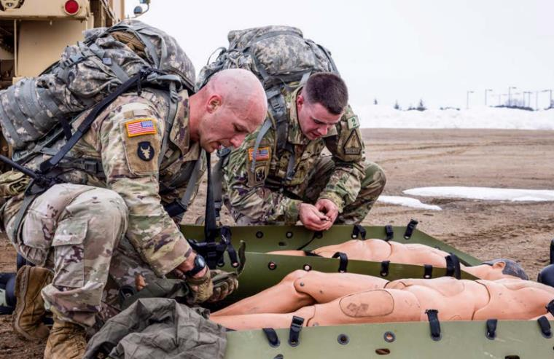
Med det
The Medical Detachment, located in Cottage Grove
Oversees the ‘health of the force’ for Minnesota National Guard Soldiers.
Provide case management, behavioral health, licensed drug and alcohol support, and conduct Soldier Readiness Processing for the state.
The Medical Detachment and Office of the State Surgeon merged to become a major support command on October 1, 2023.
Notes:
The Medical Detachment, located in Cottage Grove has a strength of 34 Soldiers in headquarters and 105 in their subordinate units.
Accomplishments:
The Minnesota Medical Detachment became a separate unit on October 1, 2023. The team conducted readiness processing for over 1,000 mobilizing Soldiers during training year 2023.
Due to their Friday Clinic operations and drill weekends, they directly resulting in the Minnesota National Guard being one of the top five in the nation for medical readiness compliance.
The Behavioral Health Team remained engaged in supporting 4,152 Soldiers.

Slide 28
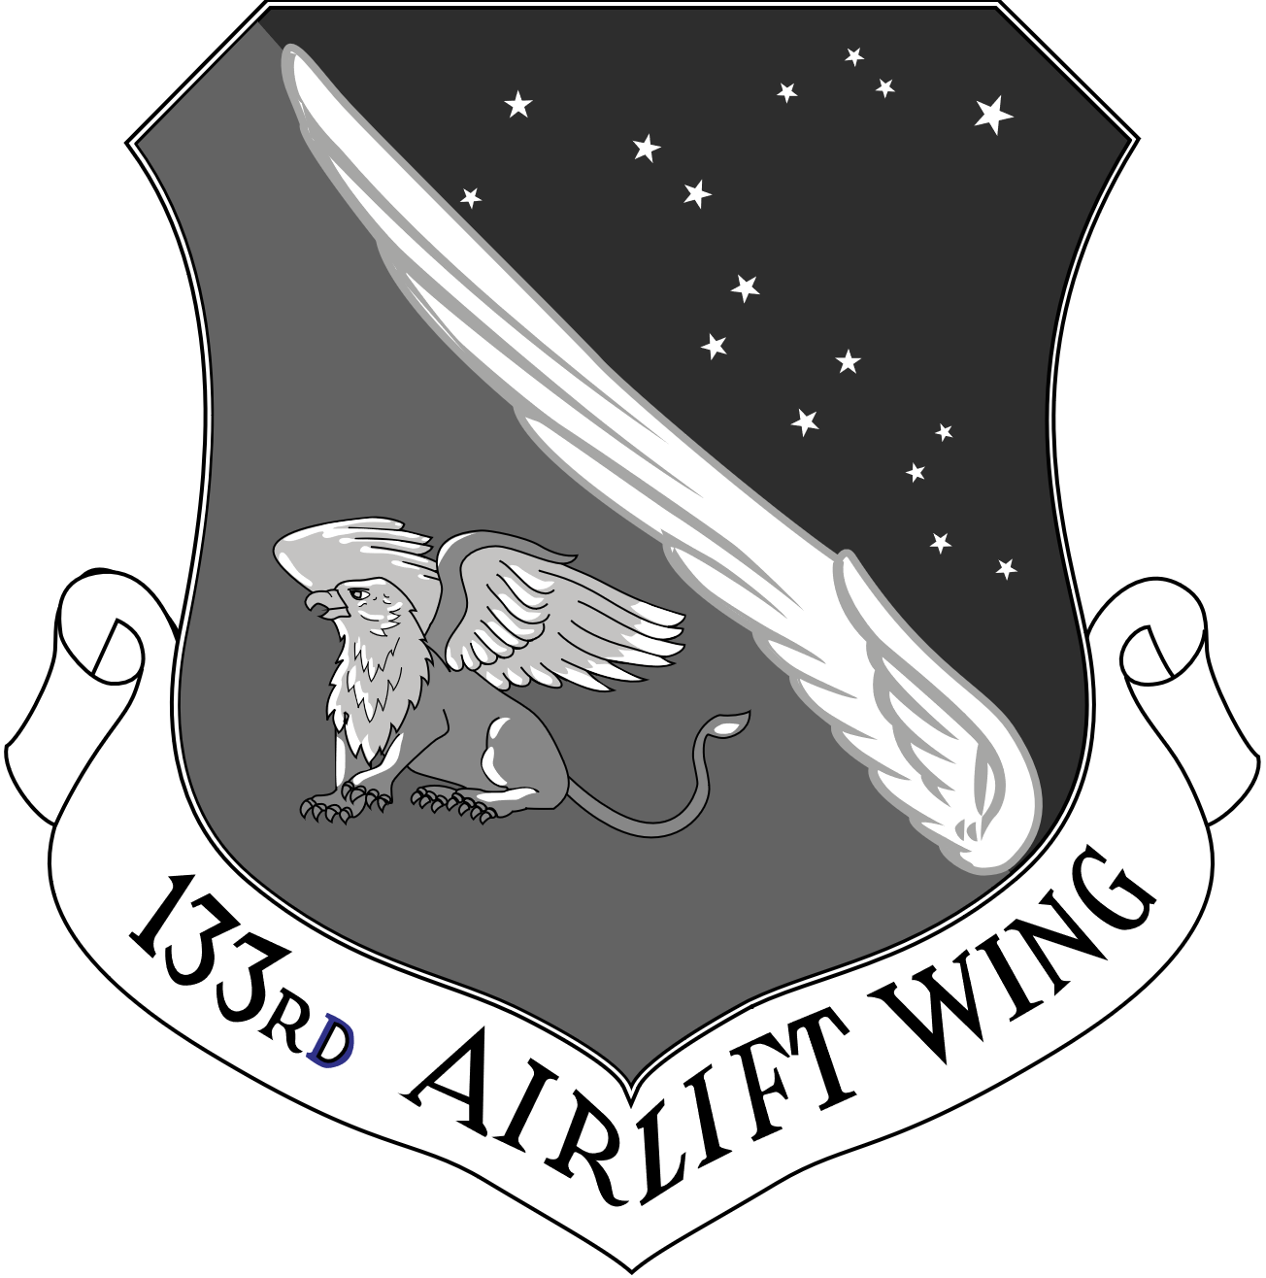
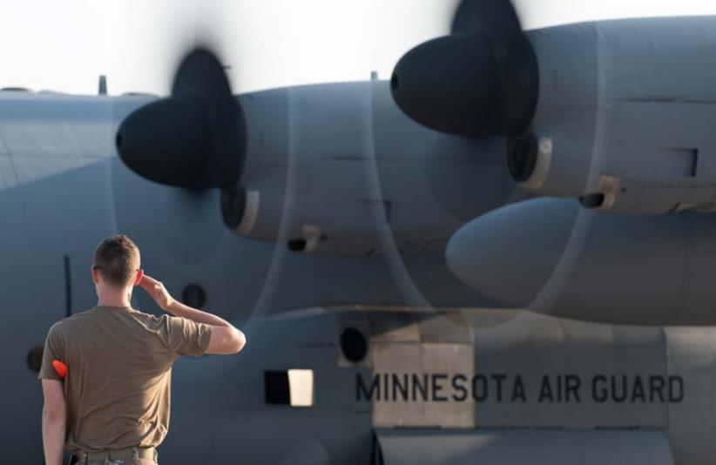
133rd aw
133rd Airlift Wing, Minneapolis-St. Paul International Airport.
The wing provides the U.S. Air Force with tactical airlift capability to transport troops, cargo and medical patients across the globe in addition to providing the citizens of Minnesota with domestic operations and disaster response support.
Notes:
133rd Airlift Wing, located at the Minneapolis-St. Paul International Airport has a strength of 1,168 Airmen.
Utilizing the C-130 H3 Hercules, the wing provides the U.S. Air Force with tactical airlift capability to transport troops, cargo and medical patients across the globe in addition to providing the citizens of Minnesota with domestic operations and disaster response support.
2023 accomplishments
In 2023, the 133rd strengthened its reputation as a premier National Guard airlift wing. This year alone, they deployed 507 Airmen to 26 locations worldwide for 28,042 deployment days.
Will receive eight new C-130J Super Hercules aircraft to improve mission efficiency further, utilize new technologies, and increase their ability to deliver logistics anytime, anywhere for the state and nation.
Participated in German Air Defender 23, the largest air exercise in NATO’s history.

Slide 29
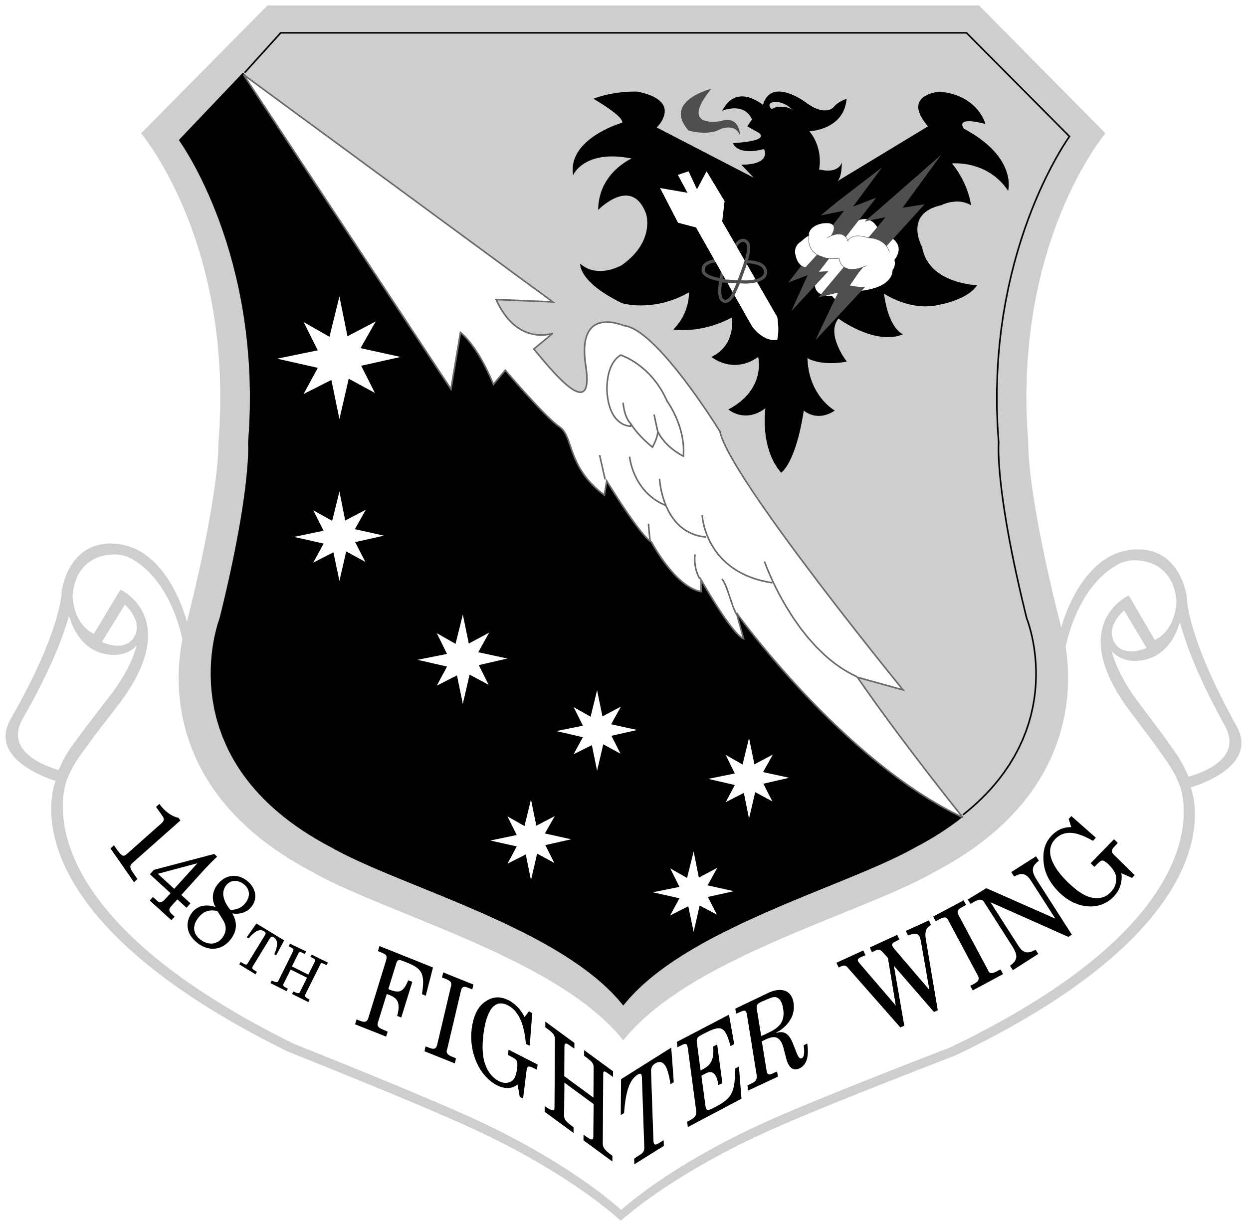
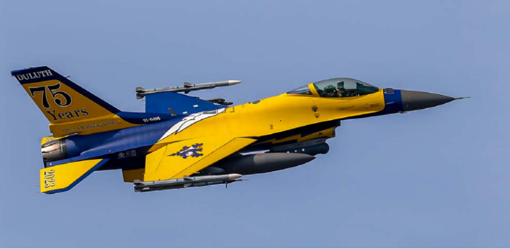
148th fw
148th Fighter Wing, Duluth
Flies the Block 50 F-16CM, the newest and most capable F-16 in the U.S. Air Force fleet.
One of only two Air National Guard wings trained to provide Suppression and Destruction of Enemy Air Defense for our nation.
Notes:
148th Fighter Wing, located in Duluth, has a strength of 1,022 Airmen
The 148th flies the Block 50 F-16CM, the newest and most capable F-16 in the U.S. Air Force fleet.
The wing is comprised of Airmen prepared to respond to federal and state missions and is one of only two Air National Guard wings trained to provide Suppression and Destruction of Enemy Air Defense for our nation.
2023 accomplishments:
Met its recruiting and retention goal of reaching 100% end-strength
148th Fighter Wing pilots and F-16s shot down an unidentified object over Lake Huron on Feb. 12, 2023, while conducting a North American Aerospace Defense Command, or NORAD, aerospace control alert.
In September, the 148th Fighter Wing celebrated 75 years of supporting our state and nation.

Slide 30
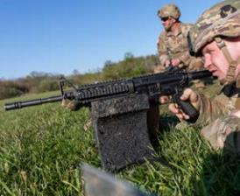
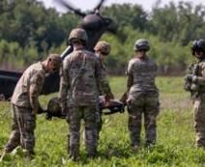
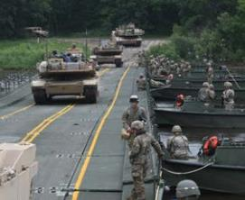
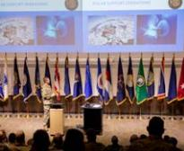
Camp Ripley
Capabilities:
45 Live Fire ranges
23 Non-Live Fire ranges
Simulations
Rail Line
Miller Army Airfield
Morale welfare & Recreation
Lodging
Education Center
Notes:
Camp Ripley, located near Little Falls, Minnesota, is a 53,000-acre regional training center hosting numerous ranges and state-of-the-art facilities to support the training requirements of military and civilian agencies. The training center provides service, resources and facilities that empower organizations to conduct essential training. Supporting a wide range of customers, from local law enforcement agencies to all branches of the Department of Defense, Camp Ripley is a primary training facility for Minnesota National Guard units.

Slide 31
Activations
This past year we had Soldiers & Airmen deploy and return from various missions:
332 deploy
689 return
Locations of the missions were:
Kuwait
Europe
Southwest Asia
Columbia
Romania
Columbia
Romania
Djibouti
Qatar
Antarctica
Japan
And more!
Notes:
The MN National Guard is always ready to deploy for federal and state missions. This past year we had Soldiers & Airmen deploy and return from various missions with 322 deploying and 689 returning from federal missions overseas to Kuwait, Europe, Southwest Asia, Columbia, Romania, Djibouti, Qatar, Antarctica, Japan, and many others.

Slide 32
Serve here
Education Benefits
Pay Benefits
Retirement Benefits
Career training
Healthcare & Life insurance
Incentives
Notes:
Across the nation, each branch of service has felt the struggles of recruiting, but I can proudly report that with your assistance, the Minnesota National Guard met its recruiting goals in our Army and Air branches for fiscal year 2023. Why is this important to you? When you need us, we are Always Ready, Always There, to support and defend our state and nation. As we start the new year, please keep providing us with your leads - Minnesota citizens who want to give back to the community, expand their life experiences, and obtain career skills or benefits such as healthcare or funding for higher education - Minnesotans who want to be part of something bigger than themselves.
As you can see we have benefits and incentives available to those who take the step to serve. The QR code brings you to contact information for our recruiters. Please share this as every lead provided to a recruiter helps ensure our safety and security.

Slide 33
Thank you
Notes:
Today, your Guard is 13,000 Soldiers, Airmen, and civilian employees strong. When we add the service members’ families and the civilian employers, we are in the tens of thousands- all part of our extended military family. Without your support, we could not accomplish our state and federal missions.
Thanks for your time today, and thanks for learning a bit more about our organization.
What are your questions?

